Slide 1


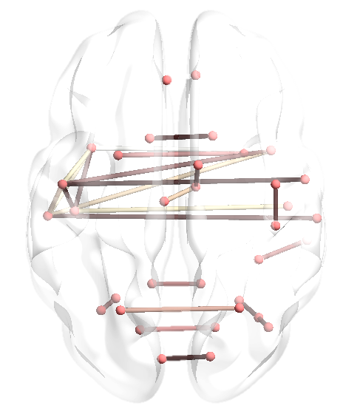
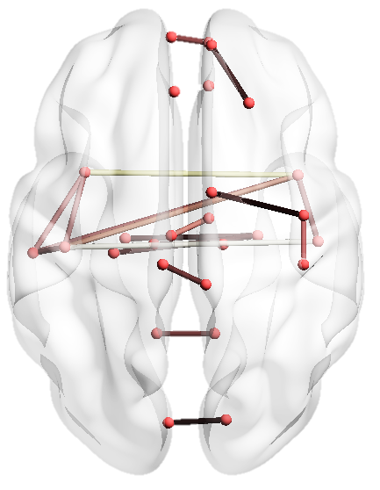
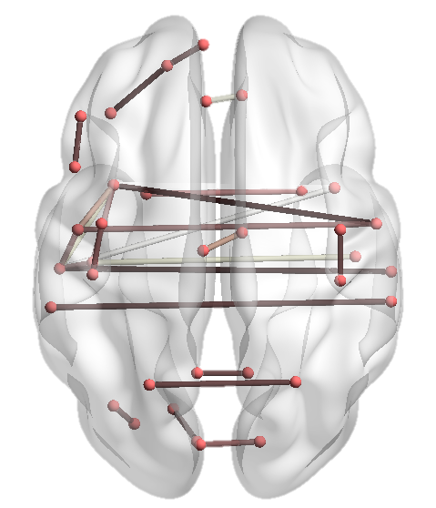
Dynamic Spectral Graph Convolution Networks with Assistant Task Training for Early MCI Diagnosis
United Imaging Intelligence
Xiaodan Xing, Qingfeng Li, Hao Wei, Minqing Zhang, Yiqiang Zhan, Xiang Sean Zhou, Zhong Xue, Feng Shi
Shanghai United Imaging Intelligence Co., Ltd., Shanghai, China
Notes:
Good afternoon. I’m Xiaodan Xing from shanghai united imaging intelligence and today I’d like to introduce you to our recent research about dynamic spectral graph convolution networks with assistant task training for early MCI diagnosis.

Slide 2
Background
Mild Cognitive Impairment (MCI)
Cognitive Functioning
Normal Aging
MCI
Dementia
Age
United Imaging Intelligence
Notes:
Mild cognitive impairment, or MCI, is a preclinical stage between normal aging and dementia. On time intervention could slow down the progression from MCI to dementia. （There are non-converters）

Slide 3
Background
MCI can be separated into early and late stages
Cognitive Functioning
Normal Aging
Early MCI
Late MCI
Dementia
Age
United Imaging Intelligence
Notes:
In order to detect MCI as soon as possible, MCI is separated into early and late stages.

Slide 4
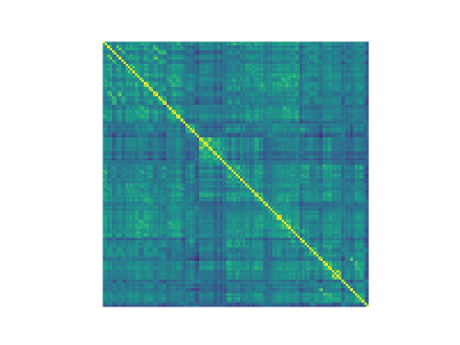
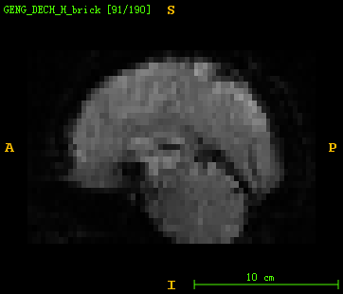
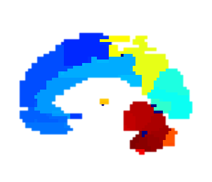
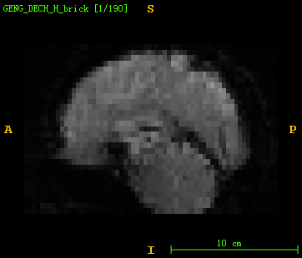
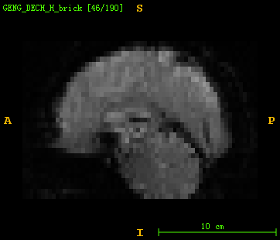
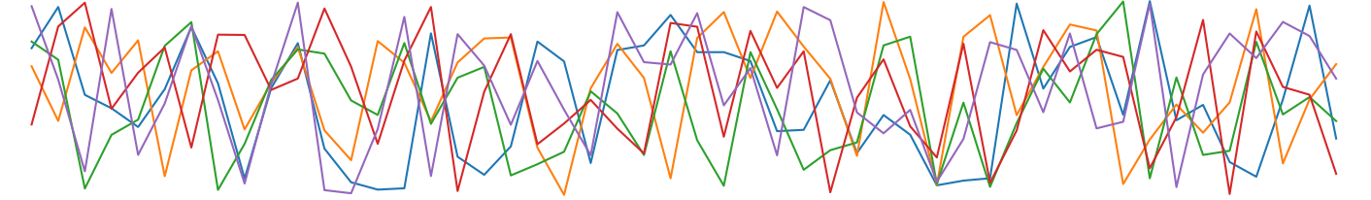
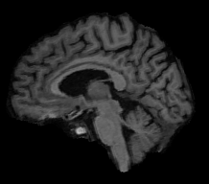


Background
Functional connectivity provides imaging biomarkers for early MCI
Cognitive Functioning
Computation of static functional connectivity
Normal Aging
Early MCI
Late MCI
Dementia
Functional MR image series
BOLD* signals for each ROI
Functional connectivity matrix
Parcellation
Age
* BOLD: blood oxygenation level dependent
Structural Image
United Imaging Intelligence
Notes:
Functional MRI which evaluates brain activations during a period of time, provides representative and discriminant markers for early MCI diagnosis. Functional brain connectivity is calculated by the correlation of functional signals between each pair of brain regions. These connectivity can be summarized in a symmetric matrix, called functional connectivity matrix.

Slide 5
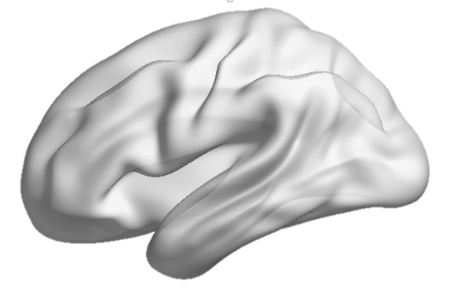

Background
Brain connectivity network can be described as a graph
Nodes $⇒$brain anatomical regions
Edges $⇒$ functional connectivity
Graph theoretical analysis
i.e., small worldness, global efficiency, …
Graph kernel
i.e., Weisfeiler-Lehman kernel, …
Feature vector for off-the-shelf classifiers
Functional connectivity matrix
Functional graph
Graph convolutional networks (GCN)
United Imaging Intelligence
Notes:
To analyze the topological structure of functional brain networks, graph analysis is introduced. Brain connectivity network can be described as a graph, with its brain anatomical regions as nodes, and functional connectivity as edges. Conventional graph analyses include graph theoretical analysis, which measures the graphical properties of brain graphs, and graph kernel which compute a vector of features from a brain graph. Both of these methods require “off-the-shelf” classifiers, like SVM and decision tree. The diagnosis procedure is not end-to-end and the parameter selection of these models can be really tricky. Thus, graph convolutional networks is proposed, aiming to learn graph representations in a convolutional neural network.

Slide 6

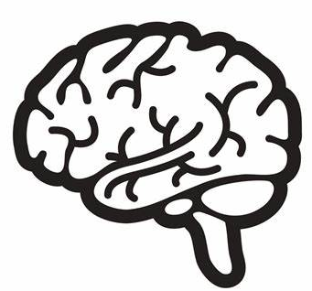



Limitation and Motivation
Static functional connectivity ignored the dynamic nature of brain
Usage of demographic information
Static graph $⇒$ Dynamic graph
Additional features$⇒$ Assistant tasks
Gender
Graph Convolutional Long short-Term Memory (GC-LSTM) network
Functional connectivity matrix
Dynamic matrices
Dynamic graphs
Functional graph
Graph convolutional networks
Diagnosis
United Imaging Intelligence
Age
Notes:
However, problems exist in graph convolutional networks. First, the connectivity of graphs are calculated from the entire time series, which is static and neglects the dynamic nature of brain. Thus, a construction and procession algorithm for dynamic graphs is required. Second limitation of conventional methods is the usage of demographic information. They were used mostly as additional input features and we’ll discuss later why demographic inputs sometimes may not help us to learn diagnosis.

Slide 7
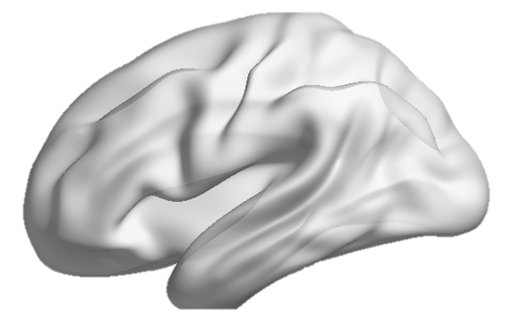
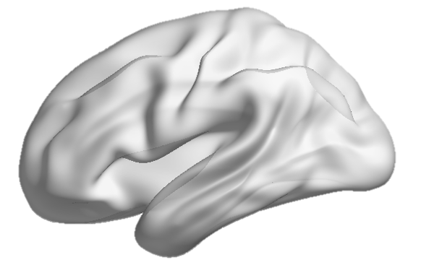

Overview
Graph Convolutional Long Short-Term Memory (GC-LSTM) structure to process dynamic functional brain graphs
Side networks for assistant tasks to guide diagnosis
GC-LSTM
FC layers
Gender
…
…
…
Dynamic matrices
Dynamic graphs
GC-LSTM
FC layers
Diagnosis
GC-LSTM
FC layers
United Imaging Intelligence
Age
Notes:
Here is a graphical overview of the proposed dynamic spectral graph convolution networks with assistant task training. Our contributions include graph convolutional long-short term memory structure, or Graph convolutional LSTM structure, to process dynamic functional brain graphs and two side networks for gender and age prediction to guide diagnosis.

Slide 8
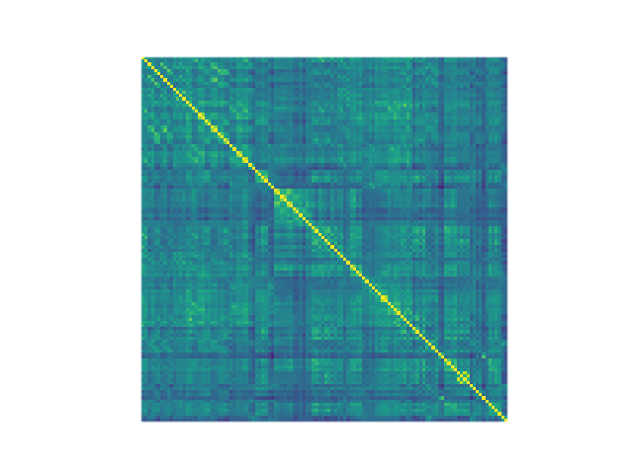
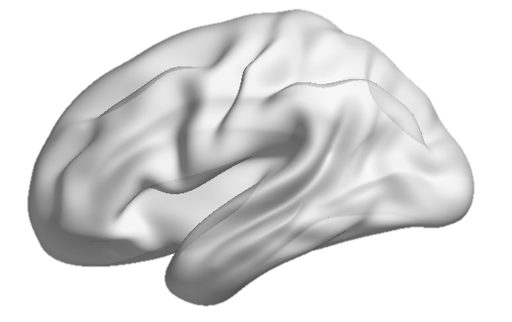
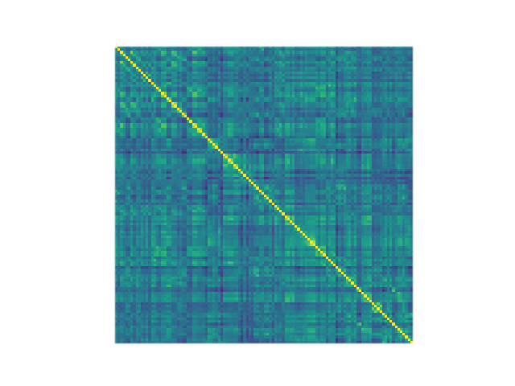
Method: Dynamic graphs and GC-LSTM
Dynamic graph construction by sliding window
Graph convolution-long-short term memory (GC-LSTM) layer
Hidden Cell
Fully-connected layers
(FC)
Hidden Cell
Diagnosis
…
…
…
…
Hidden Cell
Functional images
BOLD signal
Dynamic connectivity matrices
Dynamic graphs
United Imaging Intelligence
Notes:
First is the construction and analysis of dynamic graphs. Bold signals within a length-fixed window are used to calculate the connectivity matrix inside the window. With the connectivity matrix, we could construct a graph at this time point. The window is then shifted in time, calculating graphs within updated data points. Dyanmic graphs are then processed in a Graph convolutional LSTM hidden cell. LSTM structure, is a widely used architecture for temporal information processing. And we embedded graph convolutional operations in every hidden cell to allow them to process graphical inputs. By receiving the hidden representations learned in last cell and outputting representations for following cell, dynamic graphs are processed in order. Hidden representations from all hidden cells are then sent into fully connected layers for the diagnosis result.

Slide 9
Method: Dynamic graphs and GC-LSTM
Dynamic graph construction by sliding window
Graph convolution-long-short term memory (GC-LSTM) layer
Hidden Cell
Fully-connected layers
(FC)
Hidden Cell
Diagnosis
…
…
…
…
…
…
…
Dynamic matrices
Dynamic graphs
GC-LSTM
FC layers
Diagnosis
Hidden Cell
Functional images
BOLD signal
Dynamic connectivity matrices
Dynamic graphs
United Imaging Intelligence
Notes:
Now, with graph convolution LSTM layer, we are able to process and make predictions from dynamic brain networks.

Slide 10
Method: Assistant Demographic Tasks
Gender and age used as additional inputs
No significant demographic difference in a balanced dataset
Age, gender & patient status weakly correlated
Gender
…
…
…
Dynamic matrices
Dynamic graphs
GC-LSTM
FC layers
Diagnosis
Age
United Imaging Intelligence
Notes:
Despite of the dynamic property of the brain, demographic information, such as age and gender also affect the incidence of Mild cognitive impairment. Many studies have used these features as additional inputs. However, in many datasets, such as ADNI, the guideline of data acquisition is to balance the data distribution, such as making the male-female ratio one to one. Thus, gender, age and patient’s status is weakly correlated. Will these weakly correlated inputs help us to learn diagnosis better, probably not.

Slide 11
Method: Assistant Demographic Tasks
Gender and age used as additional outputs (assistant tasks)
Two side networks for gender classification and age prediction
Pre-trained on larger datasets
Parameter sharing by linear combination of feature maps
GC-LSTM
FC layers
Gender
…
…
…
Dynamic matrices
Dynamic graphs
GC-LSTM
FC layers
Diagnosis
GC-LSTM
FC layers
United Imaging Intelligence
Age
Notes:
Here we used gender and age as assistant tasks. Two networks with same structure but different parameter are used for gender classification and age prediction. Considering the limited number of early MCI samples, these two networks could be pre-trained on other larger datasets, such as human connectome project. Feature maps output from each layer of side networks are linearly combined and sent into the main network for diagnosis.

Slide 12
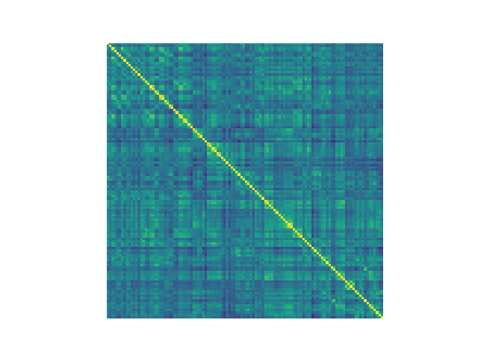
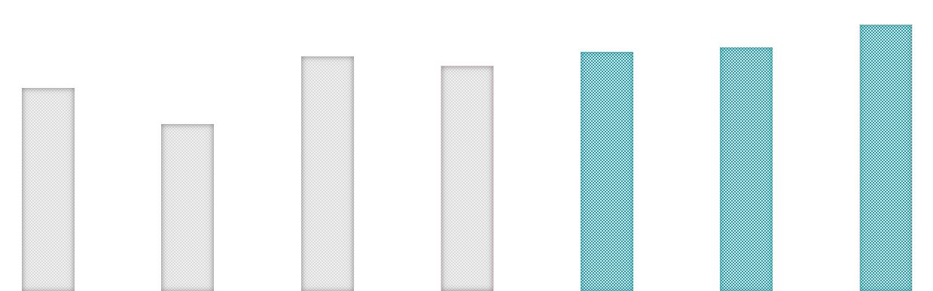

Results: Classification Accuracy
Higher classification performance has achieved on ADNI II dataset
191/177 eMCI/HC $⇒$ 294/74 training/testing
Method | SVM | CNN | GCN | LSTM | GC-LSTM | GC-LSTM + Additional inputs | GC-LSTM + Assistant tasks
Input
Accuracy
73.0%
79.7%
70.3%
67.5%
71.6%
60.8%
45.0%
Notes:
We compared the proposed method with several other approaches. First, the graph-based networks performed better than the no-graph-based methods. Adding dynamic property into conventional methods does not necessarily improve the classification performance. Dynamic graph convolution networks and assistant demographic tasks could together improve the diagnosis accuracy.

Slide 13
Summary
Conclusion
GC-LSTM is an efficient model for fMRI pattern recognition
Assistant task could improve the performance of weakly correlated features
Future works
Graph pooling algorithm
Poster Session
Wednesday, October 16
11:30-12:30, #W-7-B-116
xingxiaodan@united-imaging.com
GC-LSTM
FC layers
Gender
…
…
…
…
…
…
Dynamic matrices
Dynamic graphs
GC-LSTM
FC layers
Diagnosis
GC-LSTM
FC layers
Age
United Imaging Intelligence
Notes:
In summary, our research has demonstrated the efficacy of graph convolutional lstm structure on functional MRI pattern recognition. Besides, the assistant task setting provide a new perspective for the usage of weakly correlated features. The model can be improved in many aspects. Like graph pooling algorithm where the edges are updated after graph convolutional layers. If there are any questions, you are welcomed to our poster session, and you can reach out to me by my email.

Slide 14


